Slide 1
Lea Green June 10th – 12th
Children will arrive at school at the normal time on Monday morning and will be collected at the end of the school day on the Wednesday.

Slide 2
Aims and values:
Try everything you get the opportunity to
Be kind and helpful to others
Listen to the instructions from the staff and carry them out on time
Always have consideration for other people
Look after the centre and act in a sensible and safe manner at all times
The more effort you put in to your stay, the more you will get from it
Work as a team
Be proud of your achievements

Slide 3
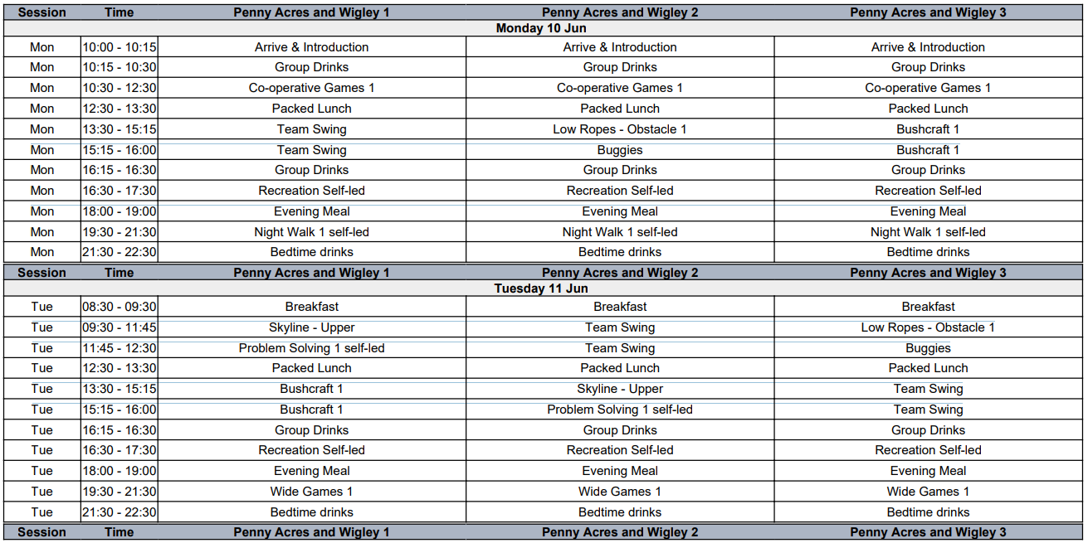
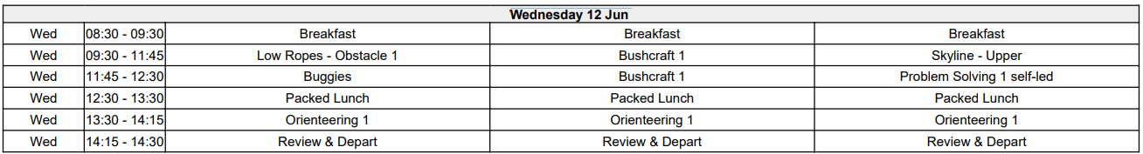

Slide 4
Kit list – make sure all clothes are named.
Waterproof coat (can be borrowed from the centre)
Warm coat/jacket
Wellingtons/hiking boots
Old outdoor shoes that will get very dirty
T shirts, trousers/jogging bottoms/leggings, jumpers
Wash bag and towel
4 pairs of underwear and socks
Sun hat/sun cream
Small rucksack/bag (optional)
Sportswear and casual clothes for the evening
Indoor trainers
Bin bags for dirty clothes
Indoor shoes/slippers
Pyjamas/night wear
Teddy (optional)
Maximum £5 pocket money (in small change please)
Torch (optional)
Small bag of sweets/snack (optional)
Re-useable drink bottle
PLEASE MAKE SURE ALL CLOTHES ARE CAREFULLY LABELLED WITH YOUR CHILD’S NAME

Slide 5
Parents:
Encourage your child to try new foods
Lights are kept on in the hallways if the children need to use the toilets at night – children will also know which room their teachers are in!
Please do not bring electrical items or mobile phones- staff will take photographs
Please let your child pack their own bag so that they know what they have with them – this will also help at the end of the course
It is better to have too many clothes than not enough!

Slide 6
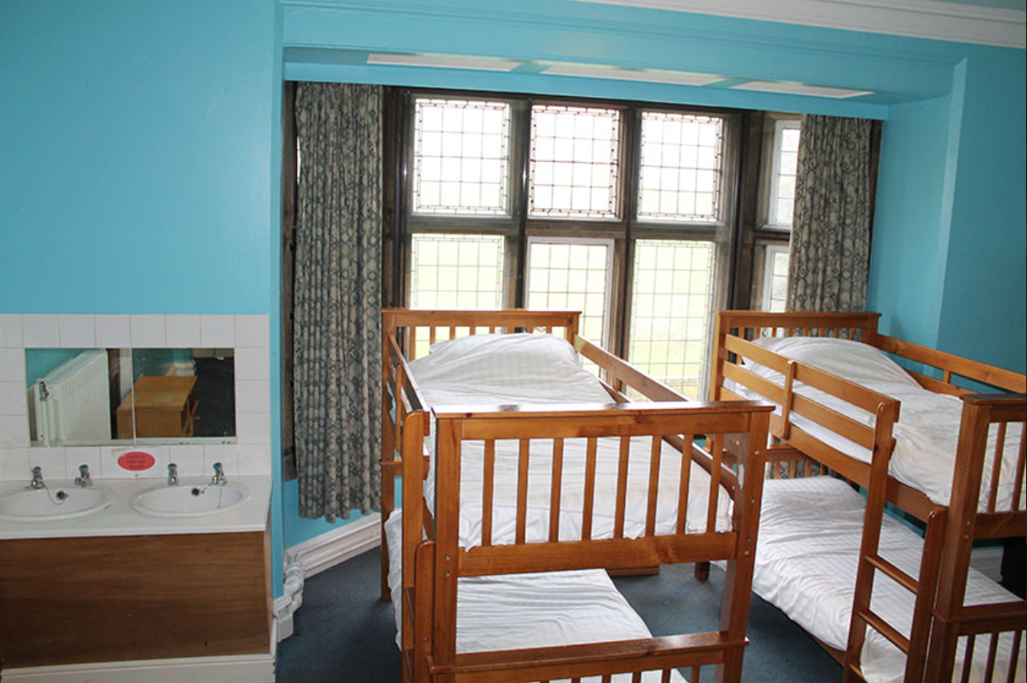
Accommodation
This is a sample of what the bedrooms look like.
Children are encouraged to keep their rooms tidy at all times.
Children are only allowed in their own rooms.
Please teach your child to make a bed prior to the visit.

Slide 7
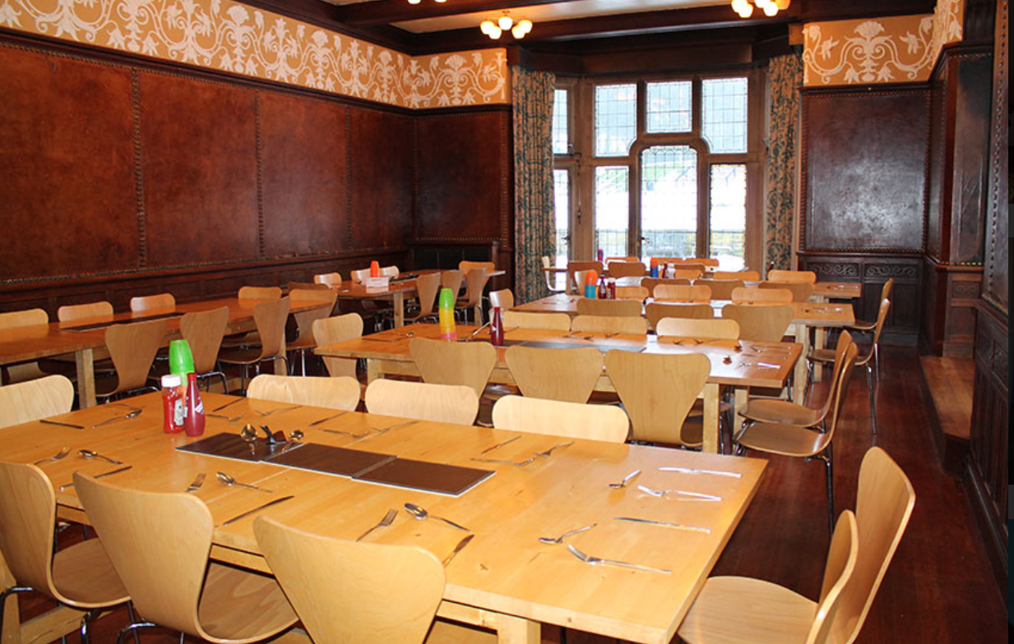
Food
All food during the visit is provided.
For sample menus, please see the Lea Green website:
https://leagreen.derbyshire-outdoors.org/wp-content/uploads/2023/12/School-Menu.pdf

