Slide 1
Relationships, Sex and Health Education Parent and Carers Consultation

Slide 2
Agenda
Why is RSE important? Views from children.
An overview of objectives/ themes across the key stages/ Year groups
RSE resources, and policies on the website
Clarify parents right to withdraw from sex education
Feedback Parent Survey Results
Examples of resources – books
Vocabulary sorting activity

Slide 3
Why is RSE important?
celebrating diversity and British Values
learning to look after ourselves – looking after our physical and mental health
developing relationships – friendships, families and people who care
showing respect, good and bad relationships
staying safe – online safety, safety at school, in the home etc.
risks – drugs and alcohol
my changing body

Slide 4
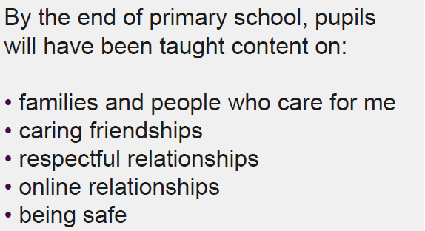
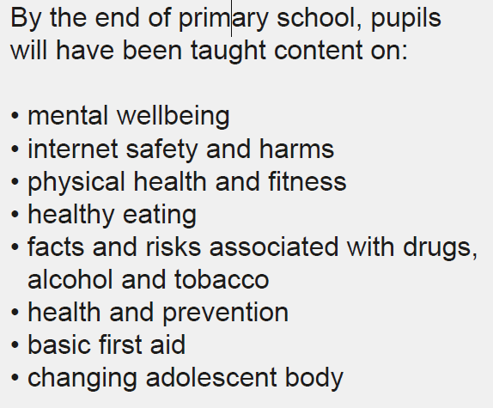
DFE-New statutory Relationships and Health Education
We want all children to grow up healthy, happy, safe, and able to manage the challenges and opportunities of modern Britain. That is why, from April 2021, all primary age children will be taught Relationships and Health Education.
Notes:
Primary

Slide 5
RSE in the curriculum
Key Stage 1 (age 5-7years)
Year 1 pupils should be taught to: Identify, name, draw and label the basic parts of the human body and say which part of the body is associated with each sense
Year 2 pupils should be taught to: Notice that animals, including humans, have offspring which grow into adults Describe the importance for humans of exercise, eating the right amounts of different type of food, and hygiene

Slide 6
RSE in the curriculum
Key Stage 2 (age 7-11years)
Year 5 pupils should be taught to: Describe the life process of reproduction in some plants and animals Describe the changes as humans develop to old age
Year 6 pupils should be taught to: Recognise that living things produce offspring of the same kind, but normally offspring vary and are not identical to their parents

Slide 7
Why is Sex Education Important ? (Sample answers taken from last year’s Y6.
I have learnt enough for my age but would like to learn more at secondary school. I’d like to learn more about respect. I think nothing has been missed out and we have learnt a lot for our age but I would like to learn more at Secondary School. I would like to learn about growing up more. I would like to learn more. Relationships and families.
Would like to learn more about periods and body changes. I would like to learn if people have the same feelings when going through puberty. What parts of puberty hurts the most. Feelings, hygiene and bodies. I would like to cover how people change through the years.
Best thing is learning about puberty. We know we will learn more in secondary school. The simple ways of teaching still help me a lot. That we can learn in separate groups to boys and then talk about that specific gender. That we can learn about gender and I like it just being the Year 5/6. It is a smaller school so it is nice we can be split into boys and girls. I DO NOT WANT to learn about this thing. We do it in groups. I like that we are in our year groups.

Slide 8
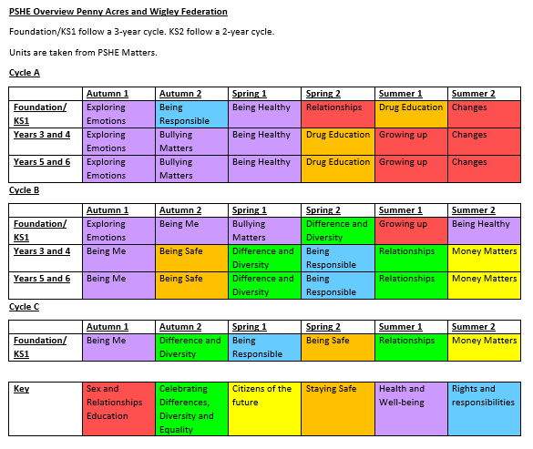
An overview of the topics/objectives in each key stage
We follow the Derbyshire scheme – PSHE matters
There are many resources on the school’s website.

Slide 9
New Government Guidance tells us
‘Parents should be given the opportunity to understand the purpose and content of Relationships Education.’
‘Parents have the right to request that their child be withdrawn from some or all of sex education.’
Give some indication of how to request, what the procedure will be in school e.g. discussion , a record kept etc
Notes:
This slide explain why we are consulting you…
Statutory requirements
Parents and carers are the prime educators of their children
Young peoples second most preferred source of information about sex is parents/ carers
Early conversations mean that they will see you as a reliable sources of information and come to you for help and support rather than turn to unreliable sources

Slide 10
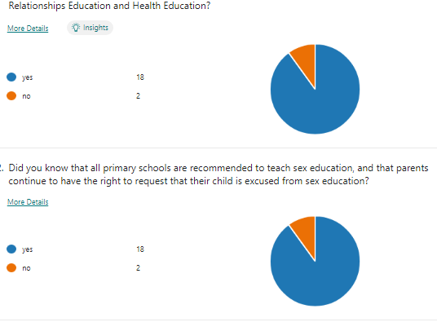
Parent Survey Results

Slide 11
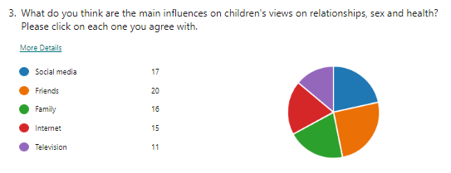

Slide 12
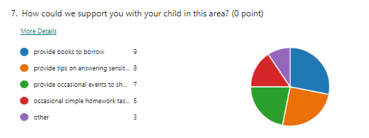

Slide 13
Any other questions?
Keep the children in mind at all stage of this and be very light in talking with them about such things.

Slide 14
Some examples of approaches and resources used across the age ranges
We use floor books for our assessment.
Books are used to help us. These are a resource that can be borrowed for home use.
We follow the PSHE Matters Derbyshire PSHE curriculum.
Planning for KS2 for sex education is revised each time it is taught in the cycle to match the needs of the cohort.
We have visits from NSPCC to talk about PANTS
https://www.nspcc.org.uk/keeping-children-safe/support-for-parents/pants-underwear-rule/

Slide 15
What vocabulary should we use at what age? Where would you put this vocabulary? Why? Should it go in more than one place?

Slide 16
Question boxes
Distancing techniques e.g. third person/story
How will lessons be delivered?
Signpost to sources of support
Dealing with confidentiality / disclosures
Books
Ground rules

Slide 17
Talking to your child- handy tips- primary
Reflect on your own experience- did my parents talk to me, did it help?
Answer their simple questions early on
Reply to their questions with small amounts of information first
Answer truthfully so they know you are reliable.
Use everyday situations to start conversation e.g. soaps..
Use books or leaflets as a prop
Let them know its ok to discuss anything
https://www.outspokeneducation.com/

Slide 18
Any further questions?

